Slide 1


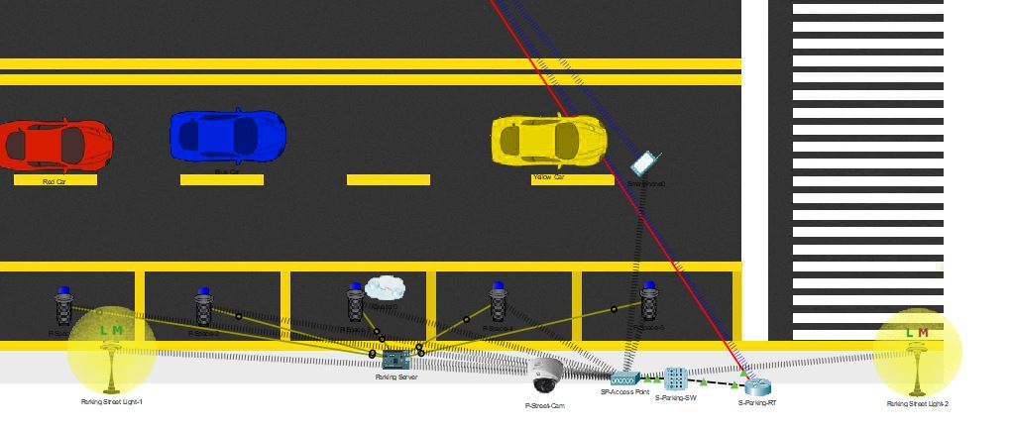
IOT CISCO SMART CAR PARKING SYSTEM
Prakash Layo Magar, Rajan Thapa , Kiran Ghale,
Amit Lama,Subin Ghimire
Baseem Al-athwari, Ph.D., Department of Smart
Computing, Kyungdong University, Republic of Korea.
Introduction
Smart Parking sensing technology is leading the way in the delivery of proven, fully integrated, end-to-end solutions, resulting in a transformation of the complete parking experience. Living in cities can be troubling. Urbanization is always expanding, and traffic in cities is becoming heavier every day. The UN Department of Economic and Social Affairs (UN DESA) predicts that all of the increase to the world’s population will live in urban areas. This increase is predicted to be as much as 68% by 2050. The population growth is not only a pressing issue for the government but a tangible daily reality for most citizens.
Smart Parking System
How Smart Parking System Works?
Smart parking development implies an IoT-based system that sends data about free and occupied parking places via web/mobile application. The IoT-device, including sensors and microcontrollers, is located in each parking place. The user receives a live update about the availability of all parking places and chooses the best one.
In order to investigate technologies behind the smart parking solution, we implemented an internal research project. The main idea was the creation of smart parking using the Internet of Things and ultrasonic sensors, where available parking places could be displayed in a web application.
Devices Use
Parking Server
Camera
Router
Mobile
Metal sensor
Switch
Street Light
Wires
Objectives
Optimized parking
Reduced traffic
Reduced pollution
Enhanced User Experience
Increased Safety
Real-Time Data and Trend Insight
Decreased Management Costs
Increased Service and Brand Image
Conclusion
Traffic management and accordingly convenient vehicle parking is a big challenge because of the booming number of vehicles worldwide. Therefore, a proper solution is required to mitigate the problem, ensure manageability, increase usability of parking slots and operate the traffic system informatively.

